Slide 1
Atlantic Coast Pipeline
Fayetteville Regional
Association of Realtors
March 15, 2016
Notes:
About Atlantic Coast Pipeline, LLC
Atlantic Coast Pipeline, LLC is a company formed by four major U.S. energy companies
Dominion (NYSE: D)
Duke Energy (NYSE: DUK)
Piedmont Natural Gas (NYSE: PNY) and
AGL Resources (NYSE: GAS)
The company was created to develop, own and operate the Atlantic Coast Pipeline (ACP), an interstate natural gas transmission pipeline designed to meet growing energy needs in Virginia and North Carolina.
The ACP would be capable of delivering 1.5 billion cubic feet per day of natural gas, through access to multiple supply basins throughout the U.S.\
The gas would be used to generate electricity as well as heat homes and run local businesses.
The underground pipeline project will facilitate cleaner air, increase reliability and security of natural gas supplies, and provide a significant economic boost in Virginia and North Carolina.
Dominion would oversee the pipeline construction and operations on behalf of the company.

Slide 2
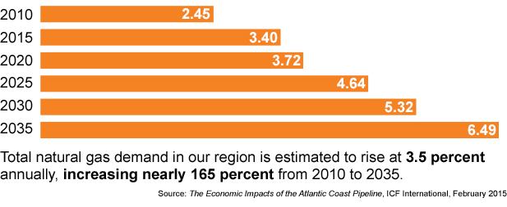
Virginia and North Carolina Natural Gas Demand (in billion ft³/day)
By 2025, the U.S. Census Bureau predicts a population increase of:
○ 1.8M in Virginia ○ 2.1M in North Carolina

Slide 3
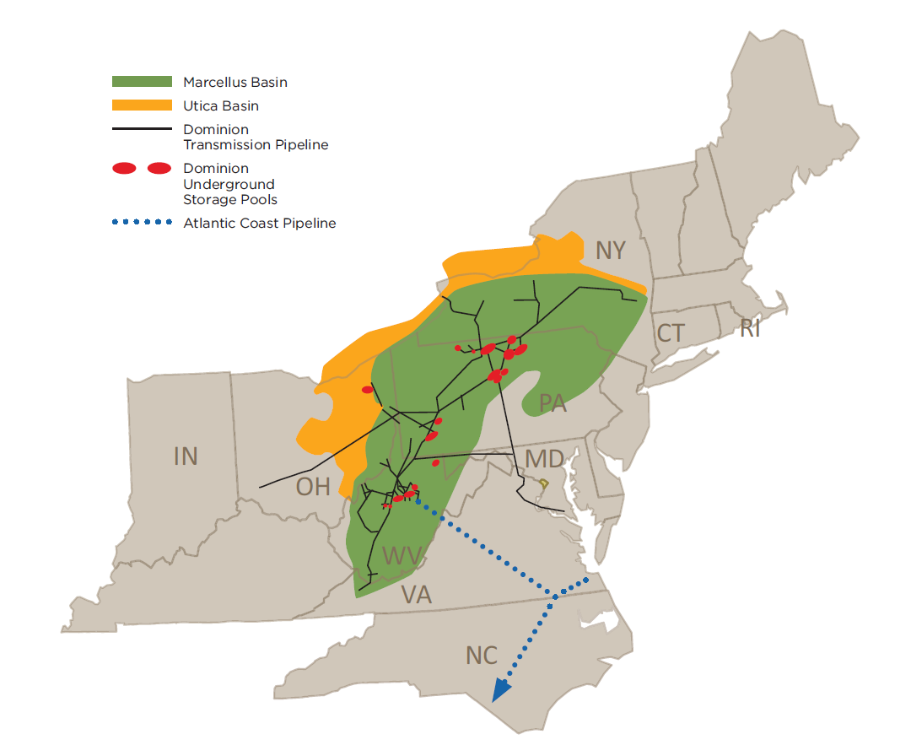
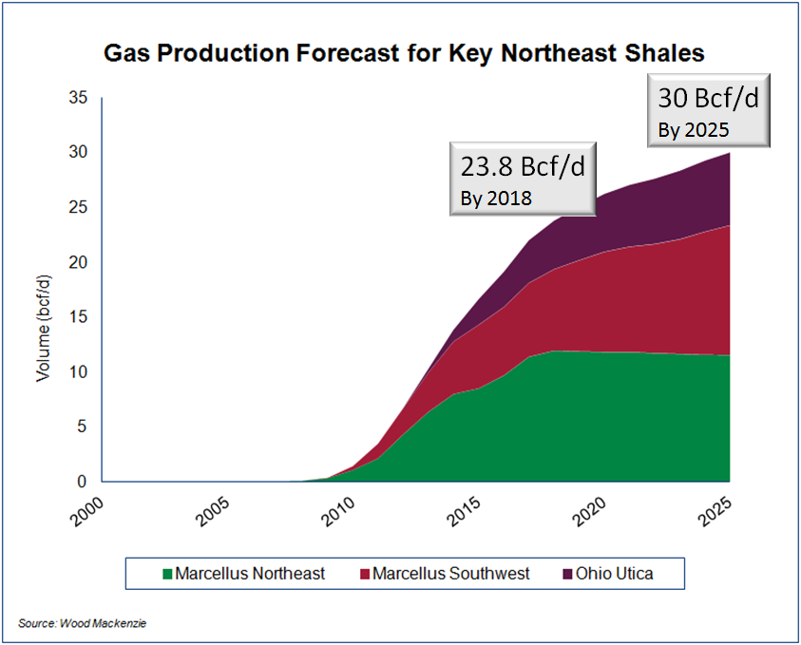
Abundant Supply of Natural Gas
Notes:
Current NE production is >13 Bcf/d
Marcellus/Utica production has been called the “Saudi Arabia” of natural gas
Production exceeds average regional demand

Slide 4
Atlantic Coast Pipeline
Ownership, Structure and Timeline
Ownership
Structure
Dominion Resources* 45%
Duke Energy 40%
Piedmont Natural Gas 10%
AGL Resources (Virginia Natural Gas) 5%
* Dominion will construct, operate and manage the pipeline
Estimated Cost
$4.5 - $5.0 billion**
** Excludes financing costs
Projected Timeline
Submit FERC pre-filing October 2014
File FERC application Late Summer 2015
Receive FERC Certificate 2016
In-Service Late 2018
Notes:
AGL Resources is the parent firm of Virginia Natural Gas
VNG supplies gas to the largest metropolitan area in Virginia (Virginia Beach, Chesapeake, south Hampton Roads)

Slide 5
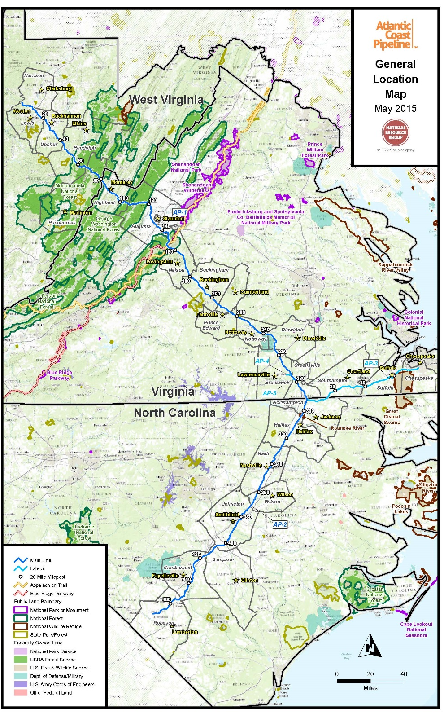
Project Details
Length: Approximately 594 miles
Pipe: West Virginia: 42-inch diameter Virginia: 42-inch diameter North Carolina: 36-inch diameter
Secondary line: 20-inch diameter
Capacity: 1.5 billion cubic feet/day
Three compressor station locations:
Lewis County, West Virginia
Buckingham County, Virginia
Northampton County, North Carolina
Route: A proposed route is being studied. Dominion is collecting data through surveys and consultations with landowners and other stakeholders to determine the best route with the least impact to the environment, and to historic and cultural resources.
Notes:
The pipeline, including a lateral to Hampton Roads, would be approximately 550 miles long.
In West Virginia and Virginia, the pipeline would be 42 inches in diameter; in North Carolina, 36 inches.
The lateral to Hampton Roads is 20 inches in diameter.
The capacity of the pipeline is projected to be 1.5 billion cubic feet of gas per day
The range of normal operating pressure on the pipeline would be from 750 pounds per square inch to 1,440 pounds per square inch, its Maximum Allowable Operating Pressure.
The pipeline is designed and built with redundant safety systems to ensure this maximum pressure is not exceeded.
Three compressor stations have been planned as part of this project – the exact locations have not been finalized, but they will be placed in Lewis County, WV; Buckingham County, VA and Northampton County, NC.

Slide 6
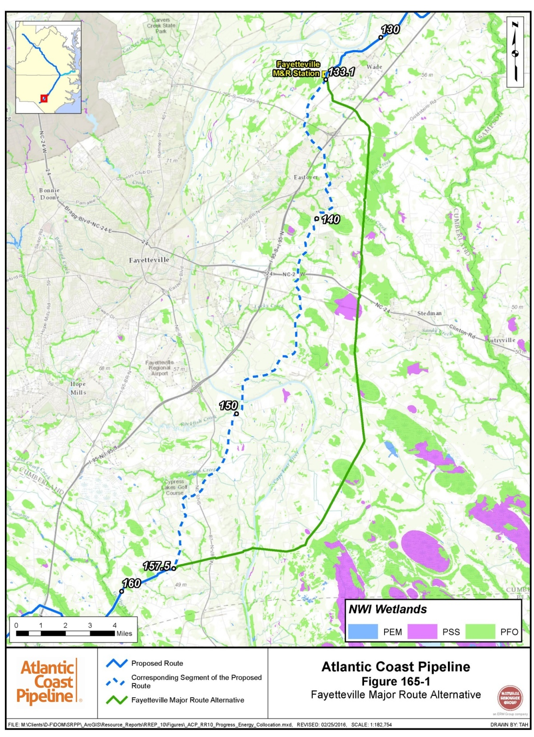
Cumberland Co.
Pipeline within county
39.5 miles
~190 parcels affected
143 landowners
Notes:
The pipeline study corridor is the blue line on this map. The 400-foot wide study corridor covers about 38 miles and 383 tracts in the county. As of May 2015, nearly 80 percent of the landowners have given us permission to conduct surveys and we are in discussion with the rest. Thank you for helping us find this best route with the least impact.

Slide 7
Tax Benefits to Cumberland County
In 2022, the full value of the project will be
reflected in tax payments estimated as follows
North Carolina counties (total for all)
Miles of pipeline: 194
Estimated 2022 property tax payments $6 million
Cumberland County
Miles of pipeline: 38
Estimated 2022 property tax payments $1 million
Notes:
One of the local benefits of the Atlantic Coast Pipeline project will be the annual property taxes paid to every county and municipality through which the pipeline will run. Those taxes will begin at a low level in 2015 and grow as the pipeline work continues
The estimates are based on:
The latest available tax rates and assessment ratios by each county.
Current income, expense and capital estimates.
All numbers are subject to revision and change
Changes in the construction schedules may affect the amount and distribution of the property tax payments in any given year
The actual tax payments will be determined by the taxing authorities.

Slide 8
Project Priority: Safety
Rigorous federal and state testing protocols
Pipeline welds are X-rayed
Thorough inspections and pressure tests prior to operation
Government-mandated operator qualification standards
Community awareness programs
Coordination with local emergency responders
24/7 monitoring from Dominion gas control center
Notes:
Photos: Monitored by air and foot patrols as well as internal inspections: Pipeline meter being visually inspected by an operator; Pipelines are also inspected from the inside by “smart pigs” which gather data to ensure the integrity of the structure – smart pigs locate deficiencies such as dents, gouges and variations in thickness
Nothing is more important than safety: this is a core value of Dominion, Duke Energy, Piedmont Natural Gas and AGL Resources
Natural gas pipelines must meet strict standards (more details on next slide)

Slide 9
Project Benefits
Reliability and diversity of supply
Cleaner air
Economic development activity potential
Economic activity during construction and operation
Support growth of intermittent renewable power sources
Employment opportunities
Property tax revenues
Notes:
Reliability/Supply
New, independent routed ensures deliverability and diversity of supply
Improves access to the most prolific and cost-competitive natural gas supply in the U.S.
Supports growing natural gas demand in VA and NC (new power generation and local distribution customers)
Economic Development
An increase in a region’s potential for economic development.
The decision to seek economic development is the county’s alone to make.
Based on our experience, a pipeline helps make that potential possible.
Sales Tax Revenue
An increase in sales tax revenue.
Construction companies purchase material and fuel.
Crews have to eat and sleep, and they will eat and sleep locally. And these would NOT be just be one-night opportunities.
Example: It takes 1 ½ days to complete a weld on a pipe and have it inspected for safety. Welds typically are needed every 40 feet.
Intermittent, renewable power sources
INSERT details from ICF report
Employment
Near-term employment opportunities. Dominion encourages companies to hire local workers whenever they can.
Property Tax Revenues
An increase in county property tax revenues from the pipeline in the ground.
Additional information about specific tax revenue benefits is available on the next slide(s)
Cleaner Air
When burned, natural gas produces significantly lower emissions than coal, including just half the carbon

Slide 10
Economic Analysis* North Carolina
194 miles of pipeline through eight counties
Total capital expenditures: $1.2 billion
Construction
Economic activity: $680.2 million total
Jobs: 4,426
Local tax revenue: $1.1 million annually
Operations
Energy cost savings: $134 million annually
Economic activity: $11.7 million annually
Jobs: 925
Local tax revenue: $6 million annually
* Analysis provided by ICF International, Chmura Economics & Analysis, and Dominion Resources.
Notes:
ACP will have significant economic impacts in North Carolina.

Slide 11
Economic Analysis
Other benefits
Enhanced gas supply security
Increased flexibility and optionality
Improved electric reliability
Support renewable generation in market areas
Notes:
Additional benefits to Virginia and North Carolina markets

Slide 12
Regulatory Process and Expected Timeline
 | Activity | Timing
_{P} | Survey/route planning | May 2014 – Ongoing
_{P} | Hosted Open Houses | September 2014
_{P} | FERC Pre-Filing Request | October 2014
_{P} | Prepare & Submit draft Resource Reports | Fall 2014 – Spring 2015
_{P} | Hosted Open Houses | January, March, July 2015
_{P} | FERC held Scoping Meetings | March 2015
_{P} | Respond to Comments submitted during Scoping | May 2015
_{P} | File FERC Application | September 18, 2015
 | FERC draft Environmental Impact Statement (EIS) FERC Comment Period/Host public meetings on draft EIS | 2016
 | FERC Final EIS | 2016
 | FERC Certificate | 2016
 | Construction | 2016-2018
 | In-service | Late 2018
FERC = Federal Energy Regulatory Commission, the lead agency responsible for environmental review and approval of the project.
Notes:
Since the project was first announced last spring, crews have been out surveying and gathering information to help determine the best route with the least impact to environmental, historical and cultural resources
This includes
Meetings with individual landowners (and surveys)
Public meetings (more on that in the next couple of slides)
Stakeholder outreach to elected officials, chambers of commerce, regulatory agencies, citizen groups, state and federal park and forest staff, homeowners associations, environmental groups, tribal entities and other business, civic and special interest organizations
Prior to the start of the pre-filing phase, Dominion hosted a series of 13 open houses along the study corridor in September 2014.
The project is currently in the Pre-application-filing phase.
ACP submitted a request to begin the pre-application process to the FERC on October 31, 2014
On November 13, 2014, the FERC accepted the application and the pre-filing officially began.
A second round of open houses was held in January 2015
The open houses provide an opportunity for the project team to share information, receive feedback from stakeholders and respond to questions about the project.
I’ll share additional information about these open houses in just a minute
3 supplemental open houses were held in March 2015 to share information about route alternatives being considered
The FERC scoping period began on February 27, 2015
FERC issued a “Notice of Intent” to develop an Environmental Impact Statement for the project
During scoping, public comments are sought regarding the “scope” of environmental review that should be conducted on the project
FERC hosted a 10 scoping meetings in March 2015.
The scoping meetings provide an opportunity for stakeholders to share information on potential environmental impacts and help determine the scope of FERC’s environmental review of ACP.
Scoping period ended on April 28, 2015
If the project is approved, we would anticipate construction being done in segments over two years.
Construction activities will be completed in one area and crews will move on to the next – segment by segment along the route
The FERC will also coordinate with other federal and state agencies to address land… air… water… species… economic… and other issues.
The proposed pipeline would be designed, constructed, operated and maintained in accordance with the FERC and the U.S. Department of Transportation and all other applicable regulations, standards and guidelines for safety.
As I mentioned, stakeholder outreach has been ongoing since spring 2014 and will continue throughout the regulatory process.

Slide 13
Transco – Northern Virginia

Slide 14
Transco – Northern Virginia #2

Slide 15
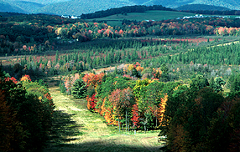
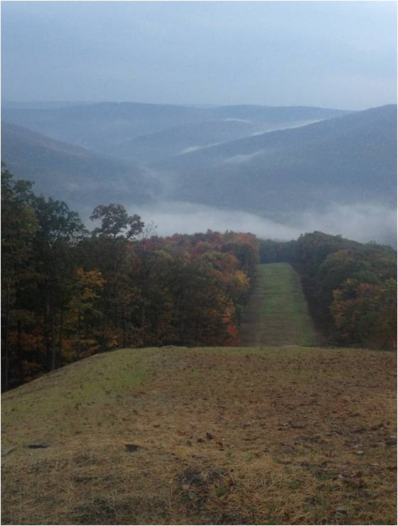
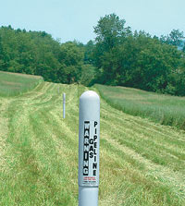
Right of Way
Notes:
Photos: Examples of natural gas pipeline rights-of-way after construction. In Pennsylvania, Dominion works with the Keystone Elk Country Alliance and the Pennsylvania Game Commission to help create safe havens and grazing areas for the elk and deer, which has resulted in a tripling of the herds. The other photographs show a right of way through a forested area and a field with a marker. Markers are placed along the pipeline route as a safety measure.
Once the best route with the least impact is determined, we begin negotiating with affected landowners to secure easement rights.
We do not buy or lease the necessary right of way, but we make a one-time payment to each landowner to secure the right to access the property to build and maintain the pipeline.
Short of building something permanent such as a building or a swimming pool or removing soil, the landowner can grow crops, raise animals, etc., in the right of way.
The right of way during construction would be 150 feet wide and after construction about 75 feet wide.
The trench would be approximately 9 to 10 feet deep. About 3 feet of soil would be under the 42-inch pipe and about 3 feet of soil on top.

Slide 16
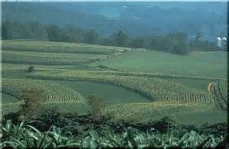
Special Considerations: Agriculture
Pipeline has four feet of cover to allow planting/plowing
Compensation rate of 200% for annual crop loss
Valuation of construction impact on loss of timber, Christmas trees and vineyards under development
Fencing, row crops, and livestock: all allowable uses of right-of-way
16
Notes:
Photo: Ag fields near Chesapeake Bay, VA

Slide 17
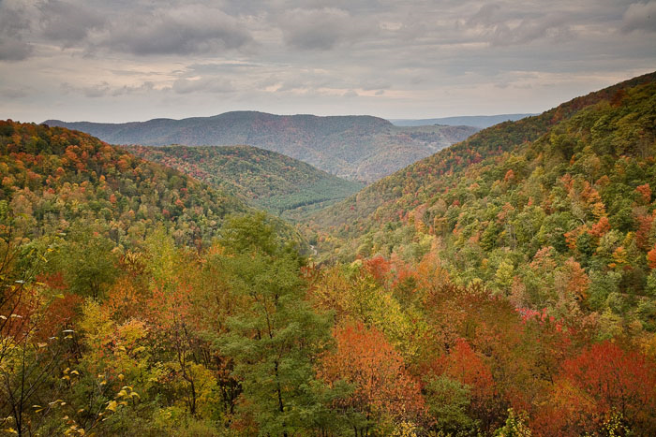
Special Considerations: Timber
Typically, Dominion will purchase and take ownership of timber, unless another agreement has been reached with the landowner
An independent 3rd party completes an inventory of the property
Evaluate by species and diameter
Provide current market value
17
Notes:
Photo: West Virginia Forestry Service

Slide 18
Environmental Permits/Authorizations: North Carolina
Anticipated North Carolina Environmental Permits & Authorizations
Permit/Approval | Agency
Clean Water Act – Section 401 Water Quality Certification | North Carolina Division of Water Resources – Wetlands Branch
Isolated wetland/Other Non 404 Jurisdictional Wetlands/Waters | North Carolina Division of Water Resources – Wetlands Branch
North Carolina National Pollutant Discharge Elimination System – General Stormwater Permit (NCG 01) | North Carolina Department of Environment and Natural Resources – Division of Water Quality
North Carolina Stormwater General Permit SWG 04 – For Linear Utility Projects | North Carolina Department of Environment and Natural Resources – Division of Water Quality
North Carolina Construction and Operation Permit (Air Permit) | North Carolina Department of Environment and Natural Resources – Division of Air Quality
National Historic Preservation Act Section 106 Clearance/Approval | North Carolina State Historic Preservation Office
Native American Consultations | Multiple
State Endangered Species Clearance | North Carolina Wildlife Resources Commission – Division of Wildlife Management

Slide 19
Project Contact Vehicles
FERC |  | ACP
U.S. Mail: Federal Energy Regulatory Commission 888 First Street NE Washington, D.C. 20426 (Reference Docket #: PF15-6-000) |  | Website: www.dom.com/ACpipeline
 |  | Facebook: Atlantic Coast Pipeline
 |  | Email: Acpipeline@dom.com
Electronic Submittal: www.ferc.gov/help/how-to/ecomment.asp: (Subject line: Docket #: PF15-6-000) |  | Landowner Toll-free Number: 888-895-8716
 |  | General Inquiry Toll-free Number: 844-215-1819
Notes:
The FERC accepts comments via U.S. Mail and electronic submittal throughout the regulatory process.
Dominion has posted a Web site for this project at www.dom.com/ACpipeline.
The site contains basic information about the project and a list of frequently asked questions.
The FAQs will be updated periodically.
The project also has a Facebook page that is monitored daily for questions and comments.
Two toll-free numbers have been set up, one for Landowners and one for General Inquiries.
Finally, the you can email questions and comments to ACpipeline@dom.com.
In short, there are ample opportunities with Dominion and with the FERC for people to make their voices heard throughout this process

