Slide 1
Chamber Sign Task Force
Fayetteville City Sign Review
April 4, 2016
Notes:
In a letter dated Jan 12, 2016, the City Council requested the Chamber assemble a Task Force to review the city’s sign ordinance.
In late January, the Chamber Board approved this request and the Sign Task Force was formed and chaired by former City Mayor Bill Hurley.
The sign Task Force met five times and provides this interim report in response to the city’s request.

Slide 2
Fayetteville Sign Review: Overview
1 - Overview a. Fayetteville City ordinances provide guidance in the construction and maintenance of signage b. Fayetteville City Code provides oversight and enforcement of sign codes | 3 - Sign Task Force (TF) Bill Hurley-Chair Don Adams Henry Tyson Richard Player Melanie Keefe Brian Kent George Breece Bruce Sykes Cam Stout Scott Shuford Peter Stewart Rod Anderson Jimmy Townsend
2 – Key Facts a. Sign Code last updated: 1997 b. Business community seeks an update c. Mayor and City Council requested the Chamber convene a Task Force to review and provide signage recommendations | 4 - Milestones Jan 12: City Council Task Force Request Jan 28: Chamber Task Force (TF) Approval Feb 10: TF Meeting #1 (Review) Feb 17: TF Meeting #2 (Sign Discussion) Mar 2: TF Meeting #3 Mar 9: TF Meeting #4 Mar 23: TF Meeting #5
Notes:
Fayetteville City ordinances provide guidance on the construction and maintenance of signage and the City’s code provides oversight and enforcement.
The overall code was last updated in 1997.
The members of the sign task force include local business members and the city staff (Scott Shuford).
The sign Task Force met five times and provides this interim report in response to the city’s request.

Slide 3
Fayetteville Sign Review: Sign Principles Motion and TF Approved 160309
1 - Existing a. Reduce excess and distracting signage b. Preserve and increase property values c. Allow effective signage while preventing signs from dominating the visual appearance of the area d. Create a more productive, enterprising and professional business atmosphere | 2 - Proposed a. Signs effectively communicate names and locations of commercial and noncommercial businesses b. Standards provide clear direction and incentives to improve sign quality c. Signs form and fit the location where they are installed; allow signs appropriate to the planned character and development of the referenced zoning districts d. Signs reflect state-of-the-art technology and materials to promote creative sign design
Notes:
The purpose of the existing sign ordinance is listed in section 30-5.L.2a. and are summarized here.
The overall proposed updates include.
a. Bottom line; That signs effectively communicate names and locations of commercial and non commercial businesses.
b. Improving quality; …Provide clear direction and incentives to improve sign quality
c. Signs form and fit the location where they are installed; allow signs appropriate to the planned character and development of the referenced zoning districts
d. Signs reflect state-of-the-art technology and materials to promote creative sign design

Slide 4
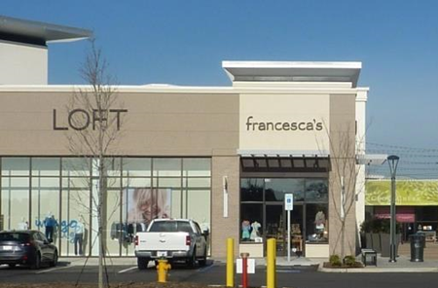
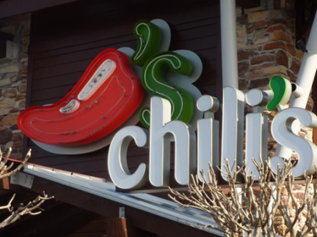
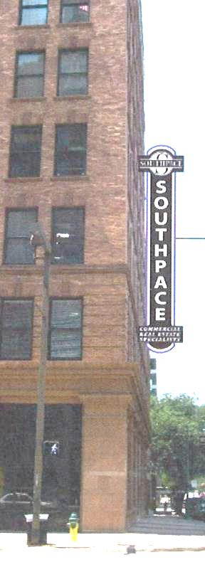
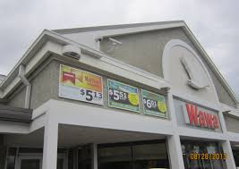
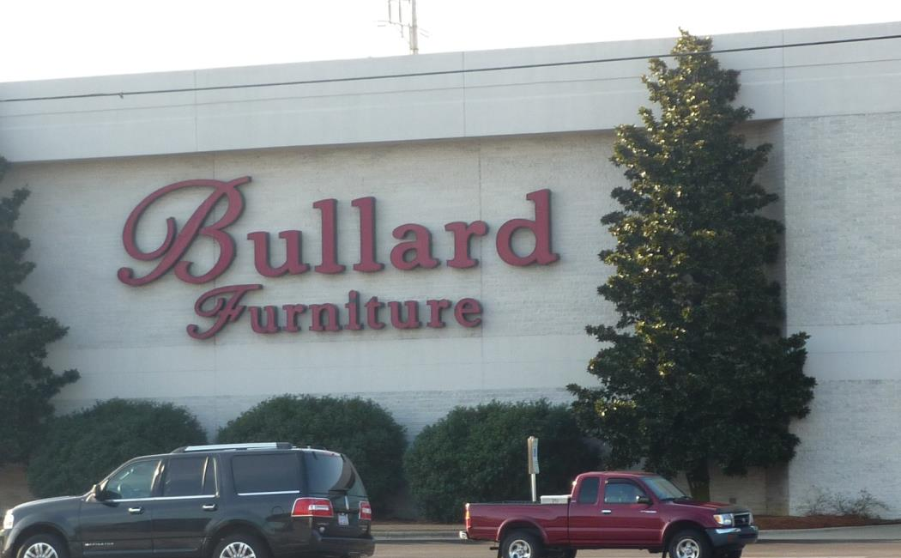
Fayetteville Sign Review: Attached Signs Motion and TF Approved 160309
1 - Current a. Attached signs not incentivized b. Projecting signs limited in size | 2 - Proposed a. 50% Bonus for Channel Lettering (1) b. 50% Bonus for 3D signs (2) c. 50% Bonus Attached vs freestanding (3) (a-c applicable per tenant) d. Eliminate size caps for projecting signs (4)
1
2
4
3
Notes:
No incentives in UDO as there are none pg 13 Table 30-5.L.8.A
Attached Signs allowed but not incentivized and projecting signs limited in size.
The proposal is to incentivize the most attractive signage.
a. 50% bonus for channel lettering
b. 50% bonus for 3D signs
c. 50% Bonus for attached vs freestanding signs
Additionally, to eliminate the size caps for projecting signs.

Slide 5
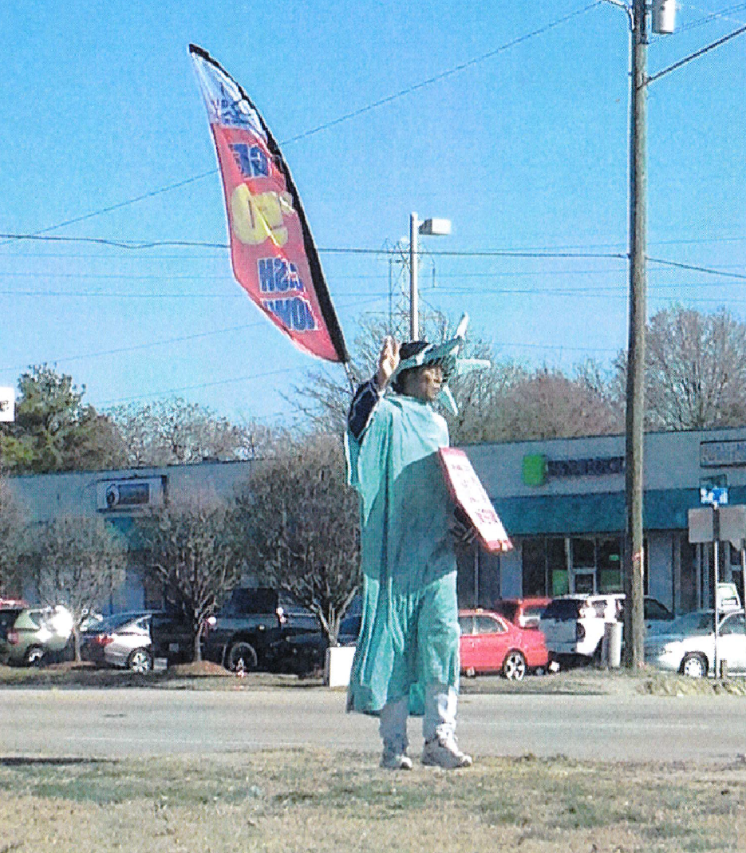
Fayetteville Sign Review: Human Signs Motion and TF Approved 160309
1 - Current a. Human Signs are allowed b. No sign limits on signs carried or attached to people | 2 - Proposed a. Continue to allow human signs b. Limit size of sign carried or worn to ten (10) square feet c. Cannot stand on public property. d. One display per frontage per tenant e. Restrict sign fabrication to banner, core ply materials or flag material
Notes:
30-5.L.5h Prohibited Signs exempt standards in Section 14-190.1
Human Signs are currently allowed with no limits.
The Task Force Proposal is to continue to allow human signs.
There were questions regarding safety related to where the sign holder can stand and the size of the sign based on potential wind condition that might make the sign unmanageable.
The proposal is to:
b. Limit the size of sign carried or worn to ten (10) square feet
c. To specify that the sign holder not stand on public property.
d. Allow only one sign holder per frontage per tenant.
e. Restrict the sign materials to banner, core ply or flag materials

Slide 6
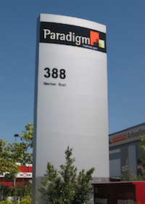
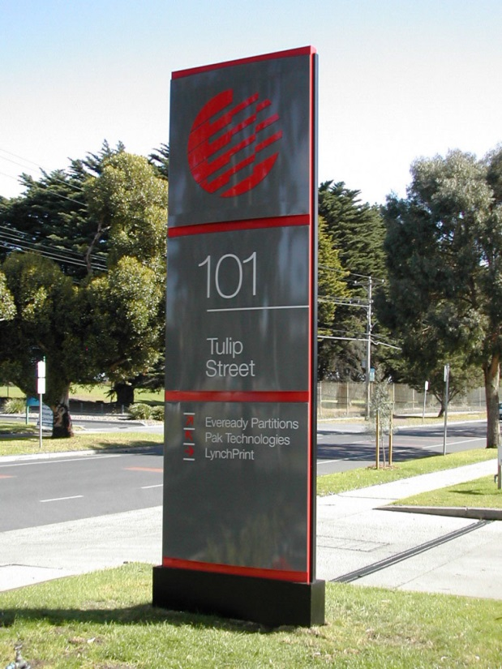
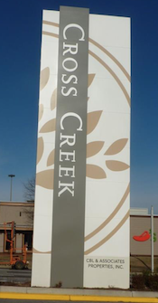
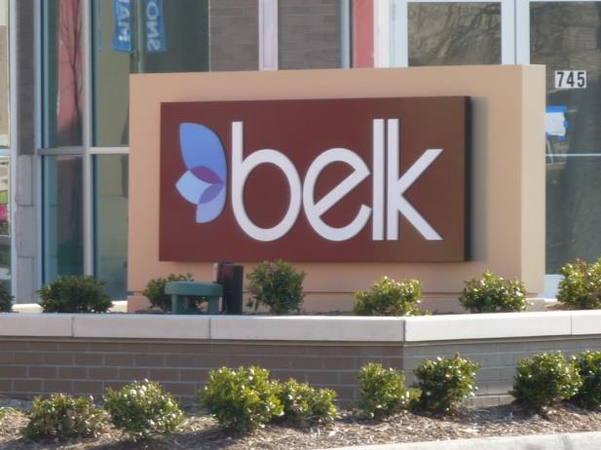
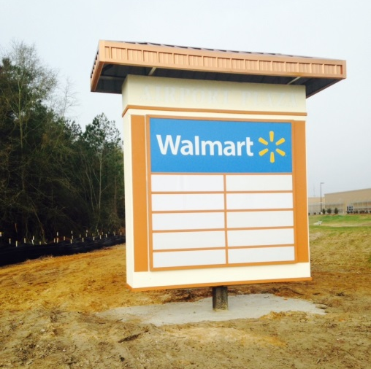
Fayetteville Sign Review: Ground Signs Motion and TF Approved 160309
1 - Current a. Ground signs are more limited in height compared to pole signs b. 8 foot maximum in most commercial districts compared to 25 feet for pole signs | 2 - Proposed a. Increase height for ground signs to promote their use b. 20 feet maximum in most commercial districts
Notes:
Pg. 13 Table 30-5.L.8a
Ground Signs are currently more limited in height than pole signs. Currently ground signs are 6-8 feet in commercial districts compared to 15-25 feet in height for pole signs.
The proposal is to incentive the use of ground signs by allowing their height up to 20 feet in most commercial districts.

Slide 7
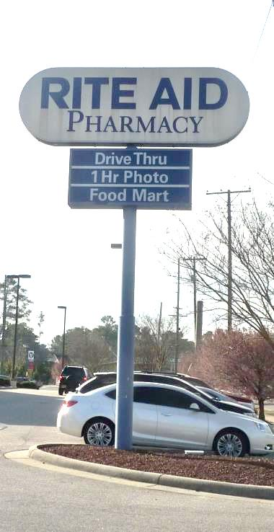
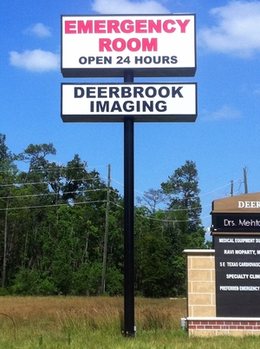
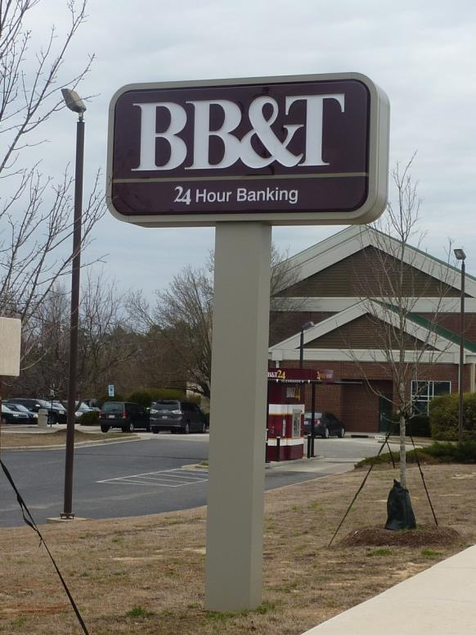
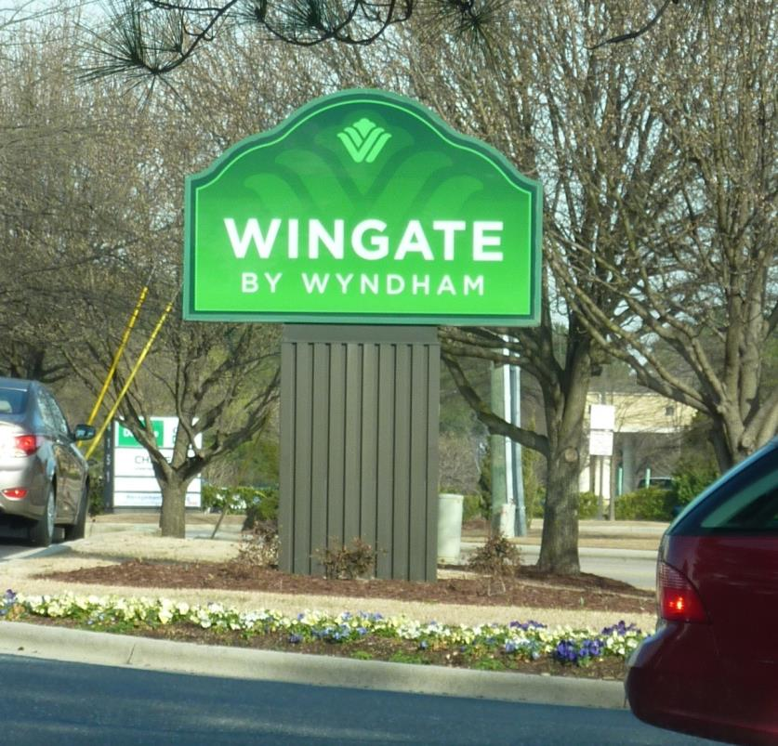
Fayetteville Sign Review: Pole Signs Motion and TF Approved 160323
1 - Current a. The definition of a pole sign limits the maximum width of the support structure to 20% of the width of the sign b. This limits the use of pole covers | 2 - Proposed a. Change the definition of a pole sign to allow the support structure to be up to 50% of the sign width b. Encourage pole covers: wrapped pole covers between 20% - 50% of the size of the sign, allowed 20% increase in area of the sign.
Notes:
Pg. 13 Table 30-5.L.8
Pole Signs are currently limited by definition and pole cover size.
The committee unanimously concurred that pole covers present a better appearance than round poles. The proposal is to incentive the use of pole covers.
Change the definition of a pole sign to allow the support structure to be up to 50% of the width of the sign.
Overall to encourage pole covers: Wrapped pole covers between 20% - 50% of the size of the sign, allowed 20% increase in the area of the sign.

Slide 8
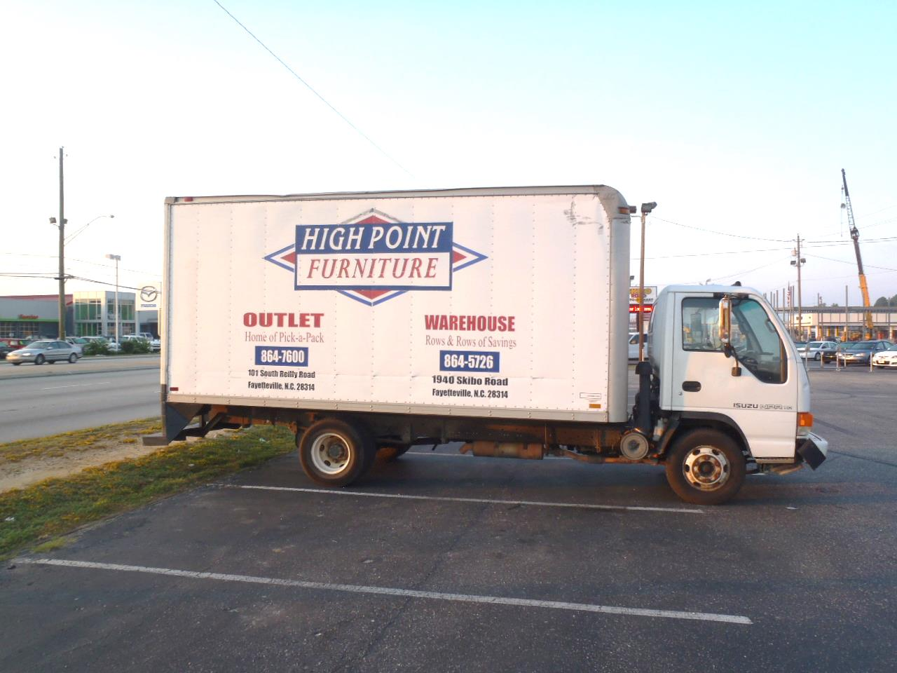
Fayetteville Sign Review: Vehicle Signs Motion and TF Approved 160309
1 - Current a. Vehicles and trailers with signs exceeding 8 sq. feet on any side can’t park within 50 ft. of public rights of way b. This does not apply when vehicle is being used in normal business activities c. Exceptions: (1) Lot size or typography require parking closer than 50 ft of right of way (2) When business inventory (such as rental trucks) must be stored within 50ft zone | 2 – Proposed Options a. Allow cars, vans and light utility trucks to park in any legal parking space on the premises being advertised if it is used in the conduct of business and is a licensed vehicle b. Vehicles larger than cars, vans and light utility trucks park 50ft of right of way
50 Ft of Right of Way
Any Legal Space
Notes:
Pg 5. 30-5.L.4.e Pg. 6 30-5.L.4.z Exemption 30-5.L.4.f

Slide 9
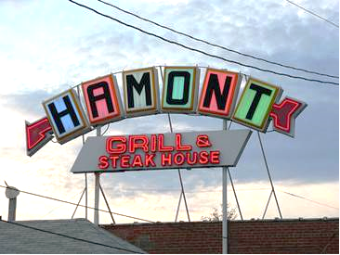
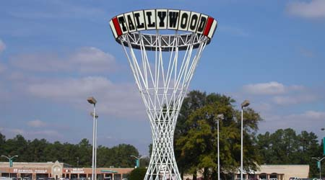
Fayetteville Sign Review: Historic Signs Motion and TF Approved 160309
1 - Current a. Must be replaced with conforming signs if damaged or removed | 2 - Proposed a. Specifically identify these signs and allow them to remain and be replaced if damaged
Notes:
Pg. 17 30-5.L.9.b

Slide 10
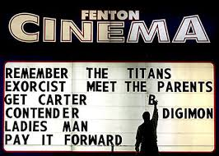
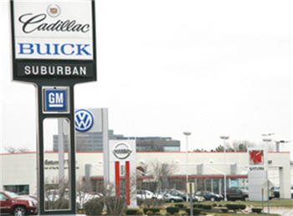
Fayetteville Sign Review: Special Use Signs Motion and TF Approved 160323
1 - Current a. Allows larger signs for theaters (1) 25% larger (2) Extra freestanding sign if part of a shopping center | 2 - Proposed a. Accommodate specific type sign needs (1) Theaters (currently allowed) (2) Auto Dealerships allow one sign per brand unique auto brand name
Notes:
Pg. 12 30-5.L.7.b.9
Peter Stewart motion; Melanie Keefe seconded to accept proposed option for special use signs. Passed by unanimous vote.

Slide 11
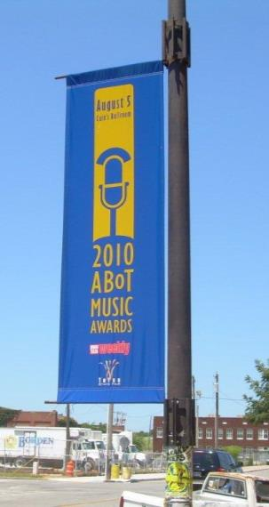
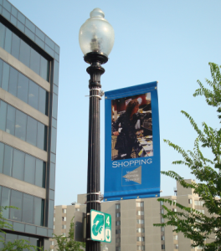
Fayetteville Sign Review: Street Banners Motion and TF Approved 160323
1 - Current a. City Council approves, specifying the location, design, display, number and duration b. The Duration shall be a minimum of 90 days and a maximum of 180 days | 2 - Proposed a. Delete duration limits
Notes:
Pg.17-18 30-5.L.10.c

Slide 12
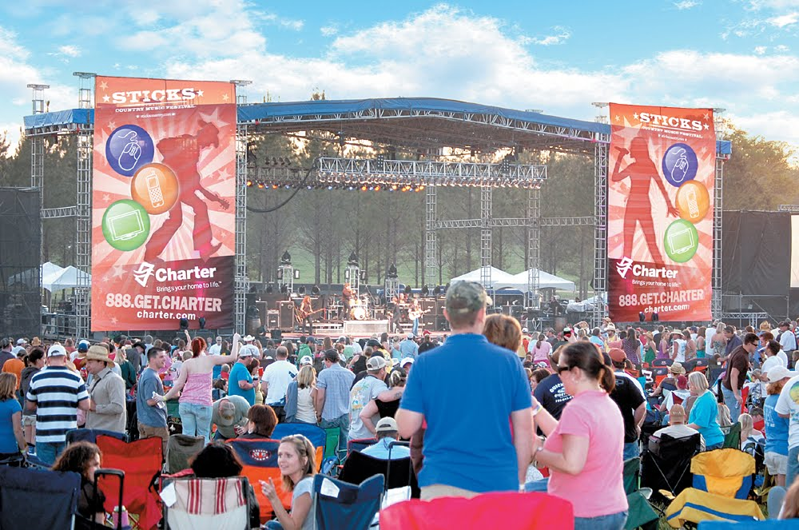
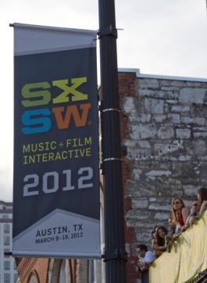
Fayetteville Sign Review: Major Special Events Unanimous TF Agreement 160323
1 - Current a. Approval by the City Manager subject to a plan specifying size, location, lighting, design, display and duration. | 2 - Proposed a. No change.
Notes:
Pg. 17 30-5.L.10.a

Slide 13
Fayetteville Sign Review: Bus Shelter & Bench Signs Motion and TF Approved 160323
1 - Current a. Advertisements are permitted on bus shelters and benches with approval by the City Manager or designee via a special use permit | 2 - Proposed a. Delete requirement for a special use permit
Notes:
Pg. 18 30-5.L.10.5
Peter Stewart motion; Cam Stout seconded to accept proposed option. Passed by unanimous vote.

Slide 14
Fayetteville Sign Review: Summary
1 - Recommendations | 2 – Next Meeting April 4, 5:00pm City Council Work Session Interim Report April 6, 4:00-5:00pm a. Review from last meeting b. Summary and Approve Presentation
a. Sign Principles b. Attached signs c. Human signs d. Ground signs e. Pole signs f. Vehicle Signs g. Historic Signs h. Special Signs i. Street Banners | j. Street Banners k. Festivals l. Bus and Bench Signs

